Slide 1
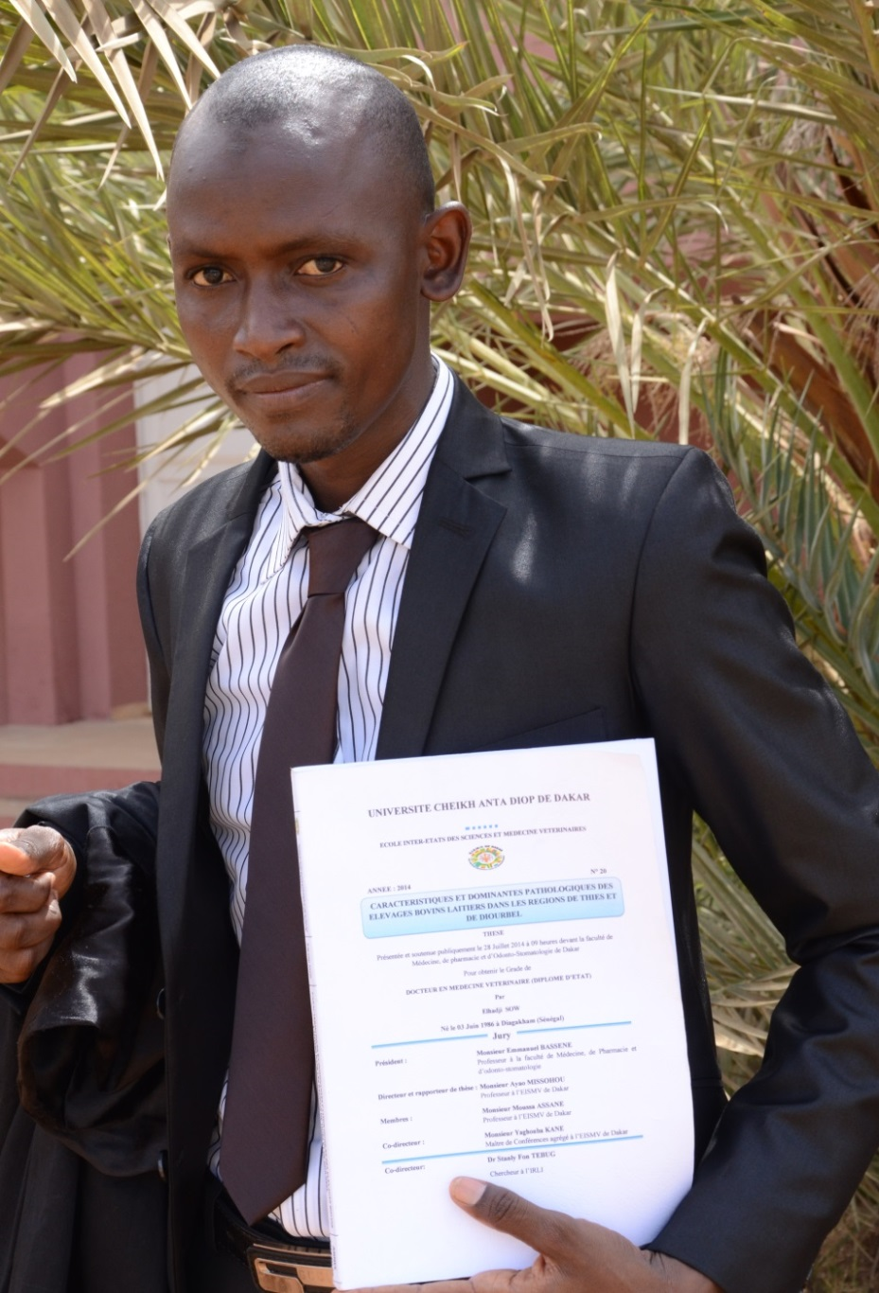
Senegal Dairy Genetics Project
Congratulates
Elhadji Sow
on successfully defending his D.V.M. thesis within the project entitled
« CARACTERISTIQUES ET DOMINANTES PATHOLOGIQUES DES ELEVAGES BOVINS LAITIERS DANS LES REGIONS DE THIES ET DE DIOURBEL »
on
July 28, 2014
The examining committee members
  Prof. Emmanuel Bassene (Faculty of Medicine, UCAD, Dakar)
  Prof. Ayao Missohou (EISMV de Dakar)
  Prof. Yakouba Kane (EISMV de Dakar)
  Prof. Assane Moussa (EISMV de Dakar)
This project is funded by the Ministry of Foreign Affairs Finland under the FoodAfrica program.

